Slide 1


Department of Artificial Intelligence and Data Science
GigRadar: Discover and Manage Freelance jobs with ease
Mrs.P. JAYASRI ARCHANA DEVI
AP-SG
SIVABALAMURUGAN G
221801050
VENKATESHAN T
221801061

Slide 2
Problem Statement
The existing freelancing platforms face challenges in providing personalized job matching, efficient project management tools, and integrated skill development resources. Freelancers often find it difficult to discover relevant opportunities, manage their projects seamlessly, and enhance their skills through targeted training. Can you design an AI-driven platform that offers a more personalized, efficient, and supportive freelancing experience?
Motivation
The motivation behind this project is to solve the persistent issues of inefficient job matching that freelancers face. By integrating AI-driven job recommendations, the platform will streamline freelancing operations, ensuring that freelancers receive relevant job opportunities.

Slide 3
Objectives
The objective of this project is to develop an AI-powered freelancing platform model that addresses key challenges like job matching, project management, providing freelancers with relevant opportunities.
The platform enhances efficiency by using AI-driven algorithms to streamline job matching, ensuring freelancers receive the most relevant opportunities based on their skills and experience. This saves time and increases productivity for both freelancers and employers. The payment system guarantees that freelancers are compensated on time, promoting trust and reliability in the process.

Slide 4
Abstract
Freelancing platforms have become crucial for connecting freelancers with employers, providing flexible work opportunities across industries. Despite their growth, current platforms often suffer from generic job matching, limited skill development, and insecure payment handling. Freelancers struggle to find jobs aligned with their expertise, while employers face challenges in identifying the right talent. Additionally, payment disputes and insufficient project management tools detract from the overall experience. The proposed solution introduces AI-driven job matching to recommend personalized opportunities based on skills and experience. AI-powered resume parsing and skill gap analysis enhance freelancer profiles, while integrated escrow accounts ensure secure and transparent transactions. Dynamic pricing strategies, powered by AI, optimize freelancer rates according to market trends. The platform also includes community support systems, peer forums, and virtual events to foster collaboration. Comprehensive project management tools further streamline workflows, enabling freelancers and employers to achieve better outcomes in a more efficient and supportive environment.

Slide 5
Introduction and Overview of the Project.
The domain of the project focuses on freelancing platforms, where freelancers and employers connect for project-based work. These platforms have become essential in the gig economy, facilitating job discovery, project management, and payment processes. With the rise of online freelancing, there is a growing need for efficient tools to match freelancers with suitable jobs based on their skills, experience, and preferences.
Existing systems often struggle with personalized job matching, security in payments, and user experience, which creates inefficiencies. Freelancers face difficulties in finding relevant opportunities, managing their work, and ensuring timely payments. Employers also encounter challenges in selecting the right talent and tracking project progress, limiting the effectiveness of current platforms.
The proposed system, GigRadar, aims to overcome these limitations by integrating AI-driven job recommendations through collaborative and content-based filtering. It enhances user experience with personalized job suggestions and a real-time messaging system. Additionally, project management tools are introduced to streamline the entire process, improving both freelancer and employer interactions.

Slide 6
Literature Survey
S.No | Author Name | Paper Title | Description | Journal | Volume/ Year
1. | M. Z. A. Zolfi and A. A. Puzi | IIUM Freelance: Secure Payment Transaction by Service Progress via Mobile Application | Focuses on secure payment transactions in mobile applications for freelancing | - | Jan. 2024
2. | K. K. Beom | Freelance Verification and Management Platform Providing System and Method | Discusses a system and method for verifying and managing freelancing | - | Nov. 2020

Slide 7
Literature Survey
S.No | Author Name | Paper Title | Description | Journal | Volume/ Year
3. | G. B. Roth and G. D. Baer | Cryptographic Key Escrow | Covers cryptographic key escrow techniques | - | Mar. 14, 2016
4. | T. T. Ke and Y. Zhu | Cheap Talk on Freelance Platforms | Analyzes communication dynamics on freelancing platforms | Management Science | vol. 67, no. 9, pp. 5901-5920, Jan. 2021

Slide 8
Literature Survey
S.No | Author Name | Paper Title | Description | Journal | Volume/ Year
5. | S. Krutylin | Freelancing as a Form of Platform Employment | Examines freelancing within the context of platform employment | Economic Scope | Jan. 2024
6. | L. Gussek and A. Grabbe | Challenges of IT Freelancers on Digital Labor Platforms: A Topic Model Approach | Analyzes challenges faced by IT freelancers on digital labor platforms using a topic model approach | Electronic Markets | vol. 33, no. 55, pp. 1-22, Oct. 2023

Slide 9
Existing System
Limited Skill Matching: Existing freelancing platforms rely heavily on keyword-based searches, which often lead to inaccurate or incomplete skill matching.
Lack of Personalization: Most current systems provide generic recommendations that do not take into account individual user preferences, past behavior, or interaction patterns.
Manual Process: The search process for finding the right freelancer or project is often time-consuming, requiring both parties to manually filter through numerous profiles and listings.
Low Engagement: Poor-quality matches reduce user engagement, as freelancers may not receive relevant job opportunities, and employers may struggle to find freelancers who truly meet their needs.
Overreliance on Ratings: Many freelancing platforms prioritize ratings and reviews as the main criteria for recommending freelancers.

Slide 10
Drawback of Existing System
The existing models do not accurately match freelancer’s skills with employer’s requirements.
Recommendations are often generalized and lack the necessary personalization to improve match quality.
The process of searching for suitable freelancers or projects is tedious and time-consuming.
Users experience lower engagement due to poorly optimized matches.
There is an overemphasis on ratings and reviews, which may not always reflect a freelancer's suitability for a specific job.

Slide 11
Proposed System
Hybrid Recommendation Engine: The proposed system combines the strengths of both collaborative filtering (based on past interactions and ratings) and content-based filtering (focused on explicit skills and preferences). This hybrid approach ensures more personalized and accurate matches for both freelancers and employers.
SVD Collaborative Filtering: The system employs Singular Value Decomposition (SVD) to analyze employer-freelancer interactions and predict ratings based on similar user behaviors. This advanced technique helps in understanding preferences and generating better matches.
TF-IDF Content-Based Filtering: Using TF-IDF (Term Frequency-Inverse Document Frequency) vectorization, the system matches freelancers and employers based on their listed skills and requirements. This enables more relevant matches by assessing the actual content of user profiles and job descriptions.

Slide 12
Proposed System
Hybrid Model for Improved Accuracy: By combining collaborative and content-based filtering, the hybrid model provides a weighted system that balances user history with specific skills, leading to more accurate and personalized recommendations.
Cold-Start Problem Solution: Unlike traditional platforms that struggle with new users (both freelancers and employers), the content-based filtering in GigRadar ensures that even users without prior ratings or interactions can still receive relevant recommendations.
Efficiency through Automation: The proposed system automates the matching process, allowing both freelancers and employers to save time and effort while ensuring better-quality matches. This results in higher engagement and satisfaction for all users on the platform.

Slide 13
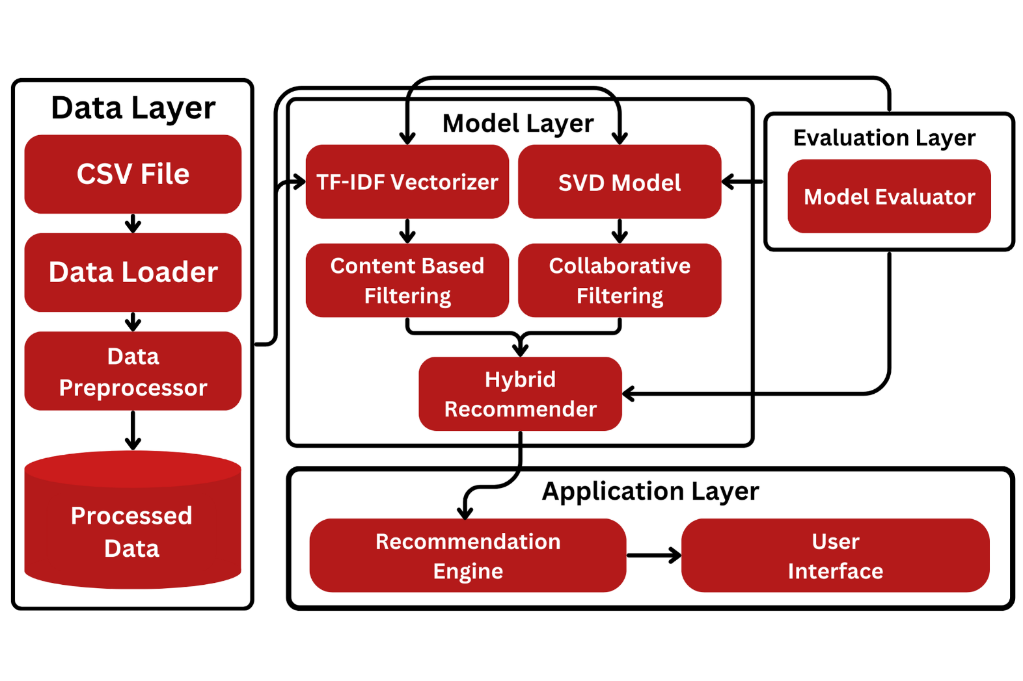
System Architecture

Slide 14
Methodology
Data Collection and Preprocessing:The initial phase involves gathering data from CSV files containing freelancer and employer information. Each dataset is processed to extract relevant features, such as preferred skills for employers and skills for freelancers. The raw data is cleaned and structured into DataFrames, ensuring missing values are handled and the data is in the correct format for analysis. This step sets a solid foundation for subsequent modeling processes by creating a user-item ratings matrix based on the skill sets of freelancers and the preferences of employers.
Model Selection and Training: The project utilizes both collaborative filtering and content-based filtering techniques to create a hybrid recommendation system. Collaborative filtering is achieved using the SVD algorithm from the Surprise library, which identifies patterns in user interactions. The content-based filtering employs TF-IDF vectorization to transform freelancer skills into a matrix that can be compared with employer preferences. The models are trained on the processed data, allowing them to learn from existing relationships and skills, thereby enhancing their ability to recommend suitable matches.

Slide 15
Methodology
Performance Evaluation: To assess the effectiveness of the recommendation models, various metrics such as accuracy, precision, recall, and F1 score are calculated. The models are evaluated using a train-test split method, where the dataset is divided into training and testing subsets. This evaluation process ensures that the models generalize well to unseen data. Additionally, RMSE and MAE are calculated to measure the accuracy of predictions, providing insights into how well the models perform in real-world scenarios.
Hybrid Recommendation System: The hybrid recommendation system combines collaborative and content-based filtering approaches to provide enhanced recommendations. This involves integrating predictions from both models, where collaborative filtering leverages user interactions, and content-based filtering focuses on skills and preferences. The system weighs recommendations based on their origin, allowing it to balance the strengths of both methods. This approach improves the overall user experience by offering more accurate and diverse suggestions tailored to individual user needs.

Slide 16
Methodology
User Interface Design: An intuitive user interface is designed to facilitate easy access to the recommendation system for both employers and freelancers. The interface guides users through different functionalities, allowing them to request recommendations based on their input data. User-friendly prompts and structured menus help enhance the overall experience. The design emphasizes accessibility and clarity, ensuring users can easily navigate and interact with the system to find relevant matches.
Continuous Improvement: To maintain the effectiveness of the GigRadar platform, a continuous improvement strategy is implemented. This involves regularly updating the models with new data to adapt to changing user preferences and market dynamics. User feedback is also gathered to refine the recommendation algorithms and improve the interface. By employing this iterative approach, GigRadar aims to enhance its performance and user satisfaction, ensuring it remains a reliable tool for freelancers and employers alike.

Slide 17
List of Modules
Data Loading and Preprocessing Module
Collaborative Filtering Module
Content Based Filtering Module
Hybrid Recommendation Module
User Interface and Recommendation Generation Module

Slide 18
Data Loading and Preprocessing Module:
Load Data: Read the CSV files containing freelancers and employers data using `pd.read_csv()`.
Data Cleaning: Handle missing values by filling them or dropping them based on project requirements. Ensure consistent formatting for skills and other textual data.
Prepare Ratings Data: Initialize an empty list for ratings, For each employer, extract their preferred skills. For each freelancer, extract their skills, Calculate a skill match score and assign a rating (1-5) based on the match and append the ratings to the ratings list.
Create DataFrames: Convert the ratings list into a DataFrame for further processing.
Prepare Content Data: Combine freelancer skills and names into a single text field for content-based filtering.

Slide 19
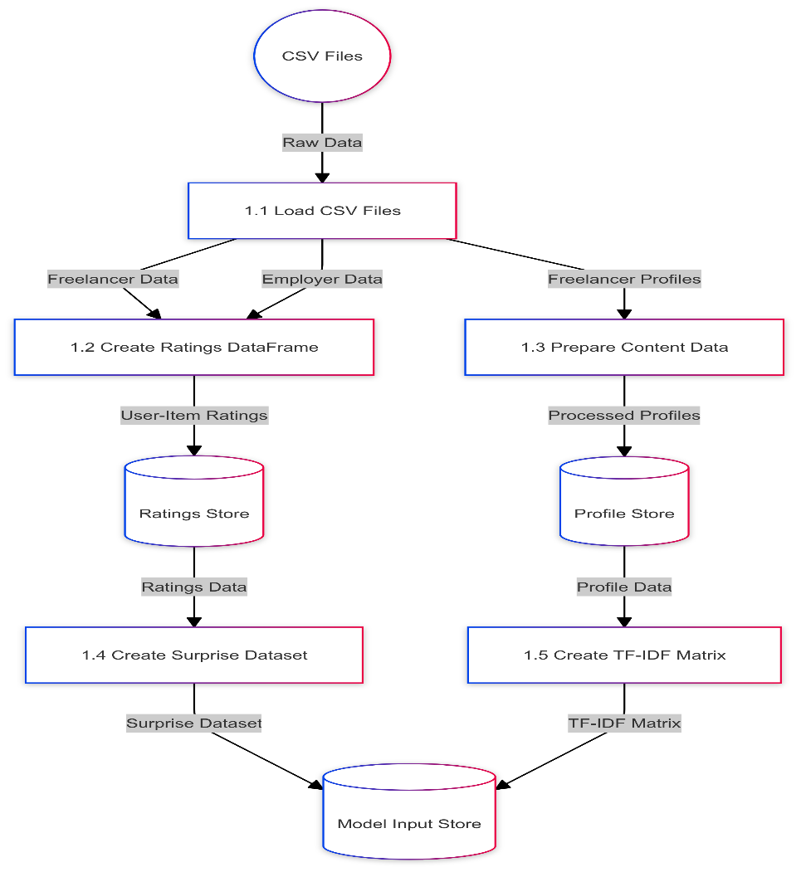
Data Loading and Preprocessing Module DFD:

Slide 20
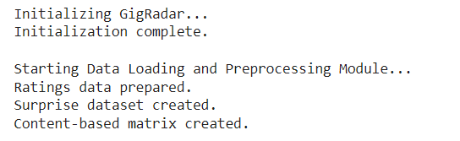
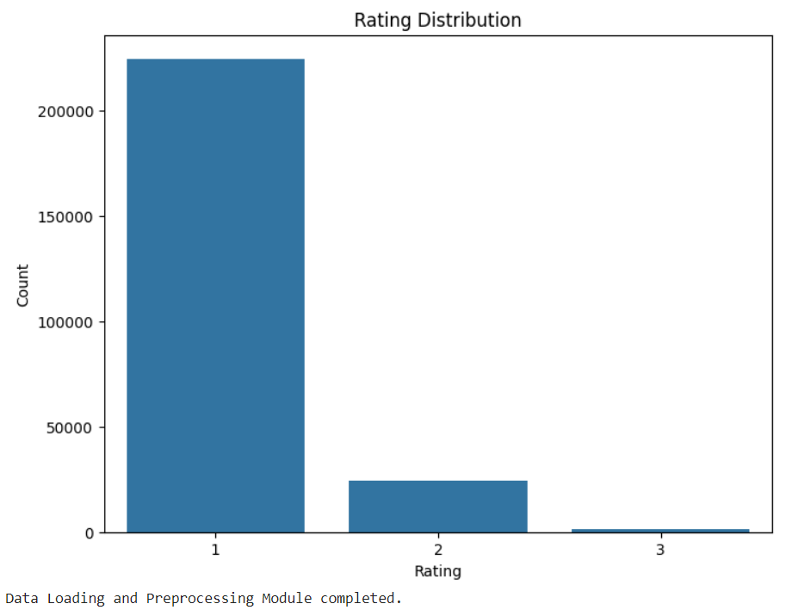
Data Loading and Preprocessing Module Output:

Slide 21
Collaborative Filtering Module:
Set Up Surprise Dataset: Use the `surprise` library's `Reader` class to define the rating scale. Load the ratings DataFrame into a Surprise dataset.
Parameter Tuning: Define a grid of parameters for the SVD model (e.g., number of factors, epochs, learning rates, regularization) and Use `GridSearchCV` to perform cross-validation and find the best model parameters.
Train the Model: Split the dataset into training and testing sets using `train_test_split()`. Fit the SVD model on the training set.
Evaluate the Model:Make predictions on the test set and Calculate accuracy, precision, recall, F1 score, RMSE, and MAE based on true and predicted ratings.

Slide 22
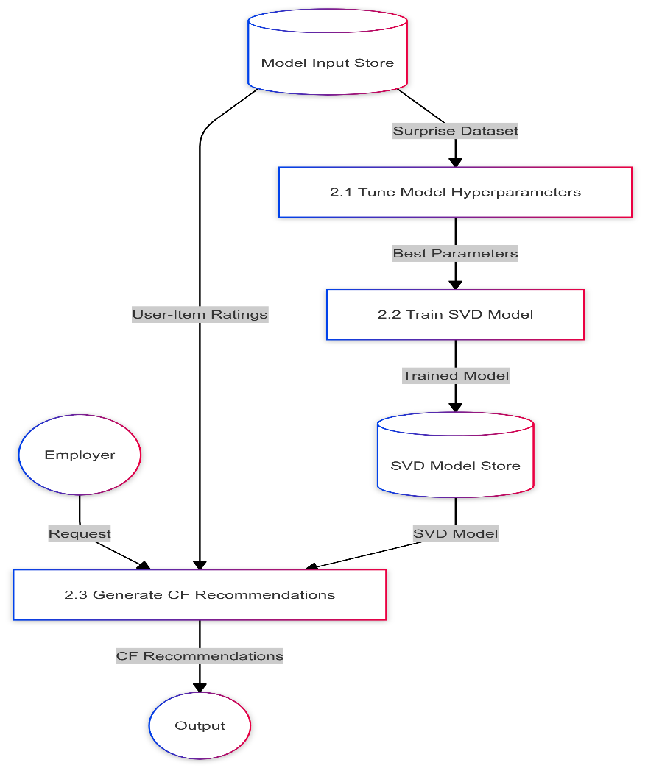
Collaborative Filtering Module DFD:

Slide 23
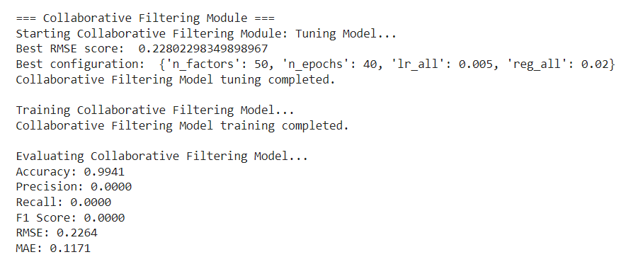
Collaborative Filtering Module Output:

Slide 24
Content Based Filtering Module:
TF-IDF Vectorization:
Use `TfidfVectorizer` to transform freelancer skills and names into a TF-IDF matrix.
Compute Similarities:
For a given employer or freelancer, create a vector based on their skills.
Calculate cosine similarities between the new vector and the TF-IDF matrix.
Get Recommendations:
Sort similarities and select the top `n` freelancers or employers based on highest similarity scores.

Slide 25
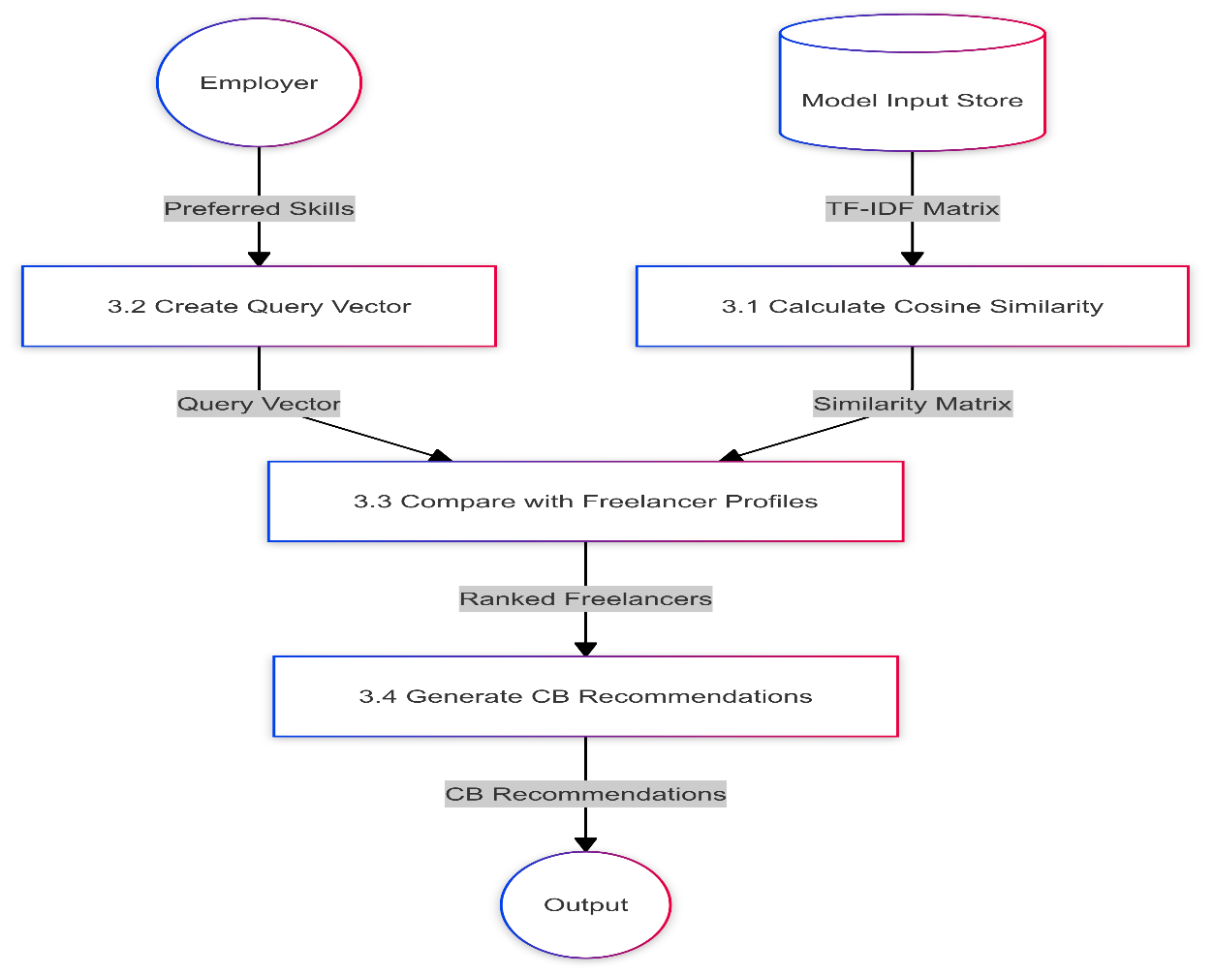
Content Based Filtering Module DFD:

Slide 26
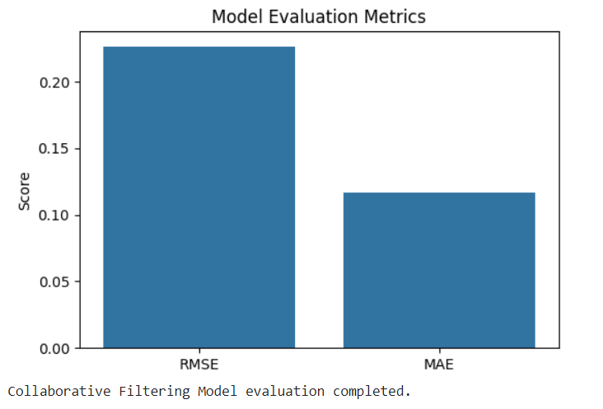
Content Based Filtering Module Output:

Slide 27
Hybrid Recommendation Module:
Get Collaborative Recommendations: Call the collaborative filtering method to get a list of recommended freelancers for an employer.
Get Content-Based Recommendations: Call the content-based filtering method to get a list of recommended freelancers for an employer.
Combine Recommendations:Create a weighted hybrid recommendation system: Assign higher weights to collaborative recommendations and Combine scores from both recommendation lists.
Sort and Return: Sort the combined recommendations based on total score and return the top `n` recommendations.

Slide 28
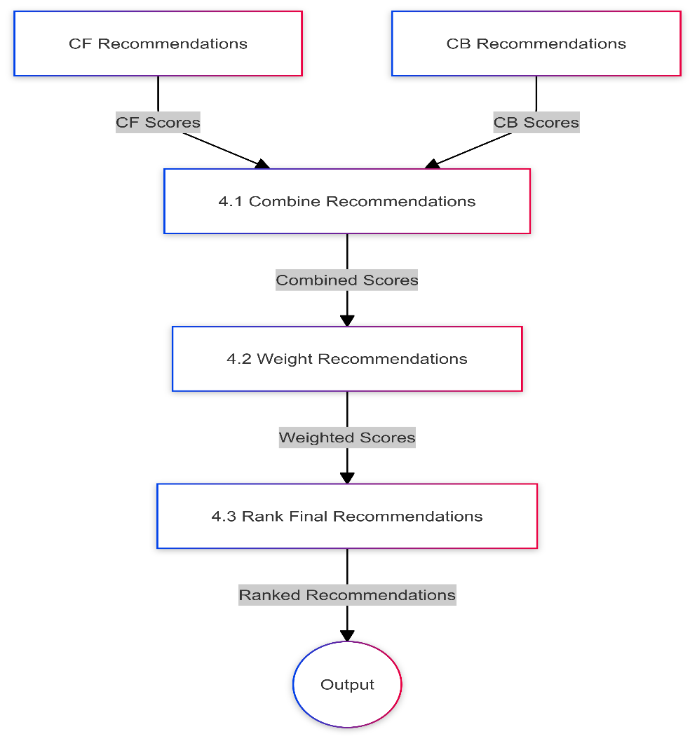
Hybrid Recommendation Module DFD:

Slide 29
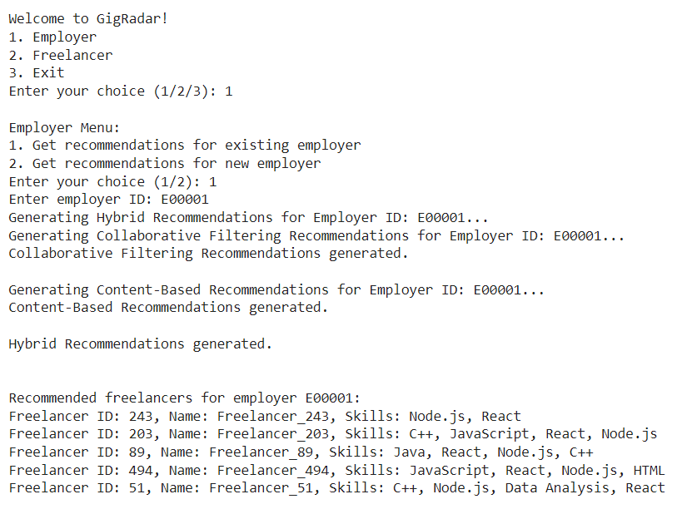
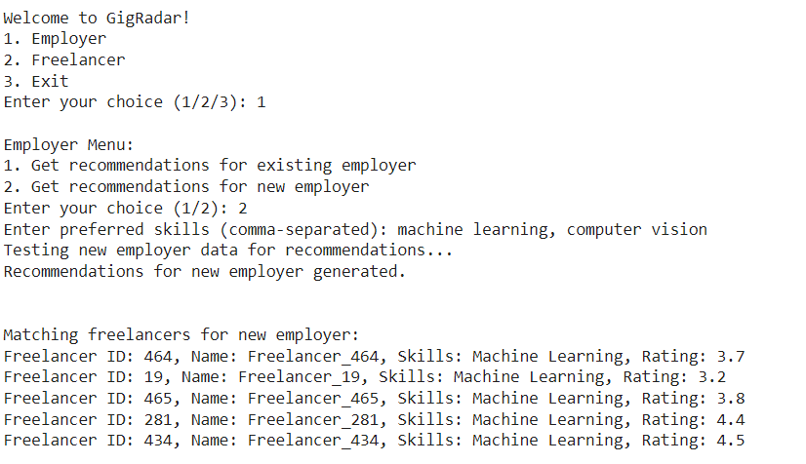
Hybrid Recommendation Module Output:

Slide 30
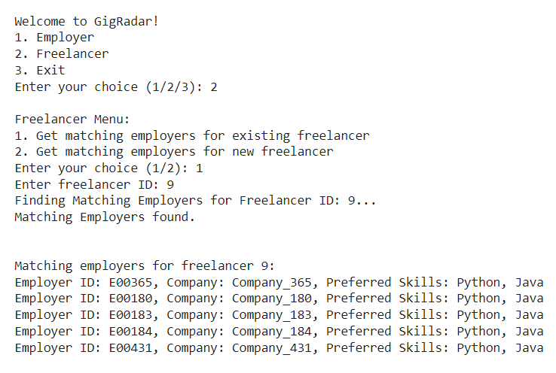
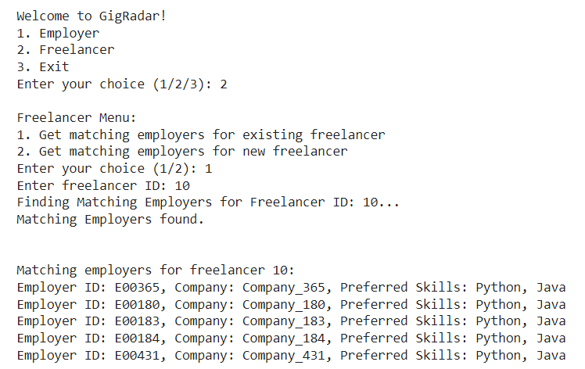
Hybrid Recommendation Module Output:

Slide 31
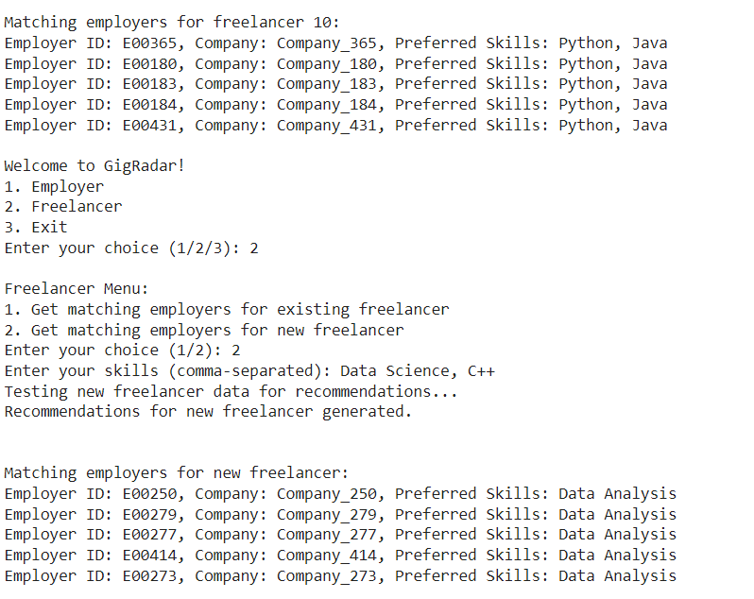
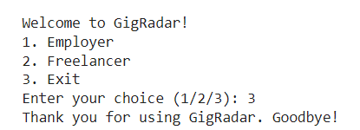
Hybrid Recommendation Module Output:

Slide 32
User Interface and Recommendation Generation Module:
User Input: Display a menu for the user (employer or freelancer) and Capture user choice for recommendations or new entries.
Recommendation Handling: For existing employers or freelancers, prompt for their IDs and fetch recommendations. For new employers or freelancers, prompt for their skills and fetch matching candidates.
Display Results: Format and display recommended freelancers or employers along with relevant information (ID, name, skills).
Loop or Exit: Allow the user to make more queries or exit the program.

Slide 33
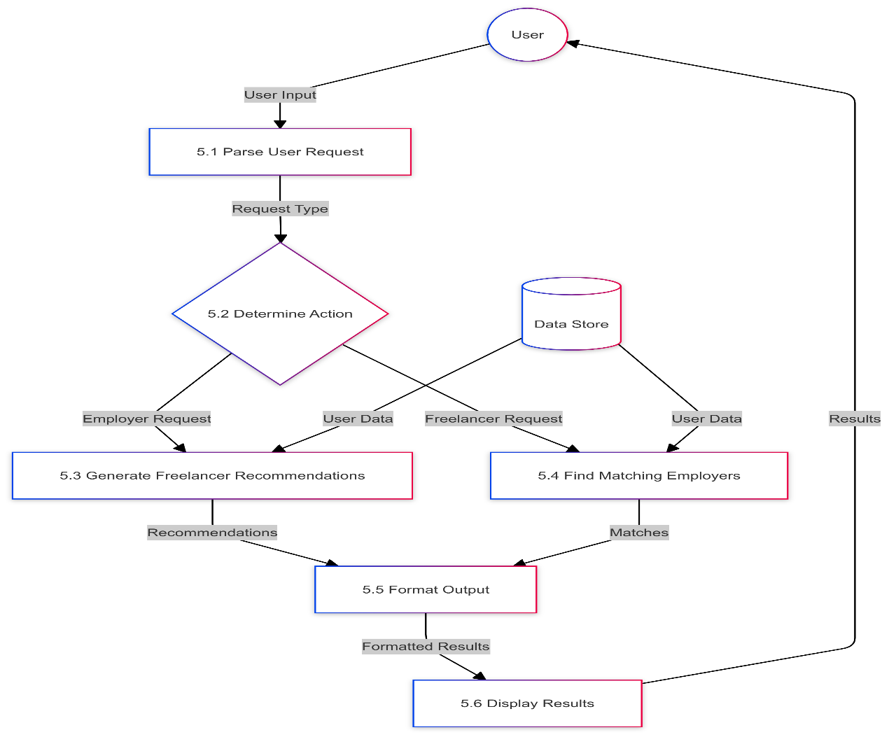
User Interface and Recommendation Generation Module DFD:

Slide 34
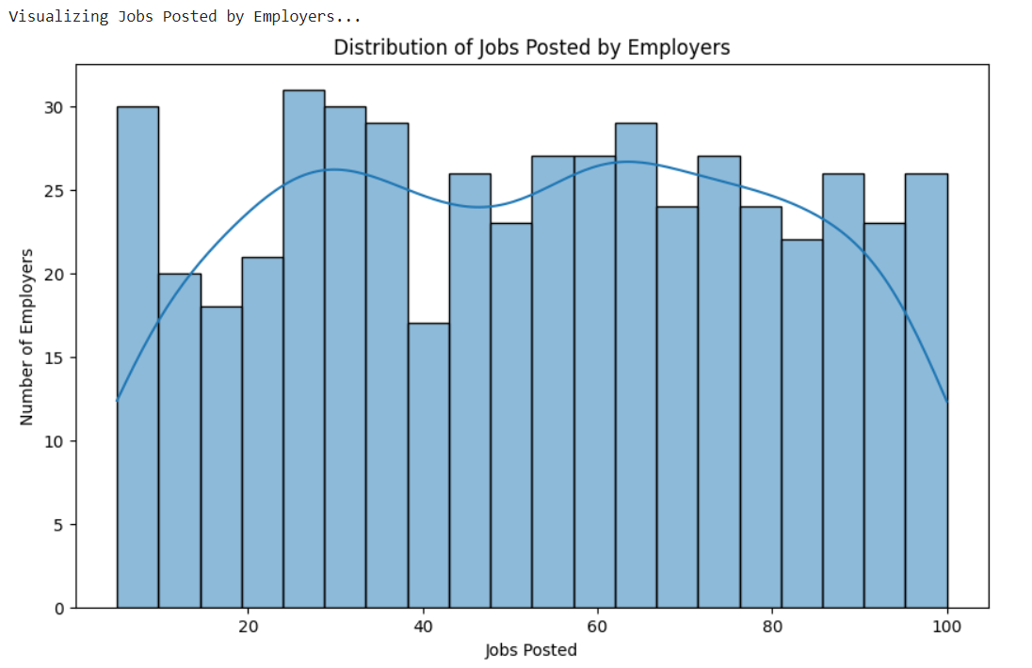
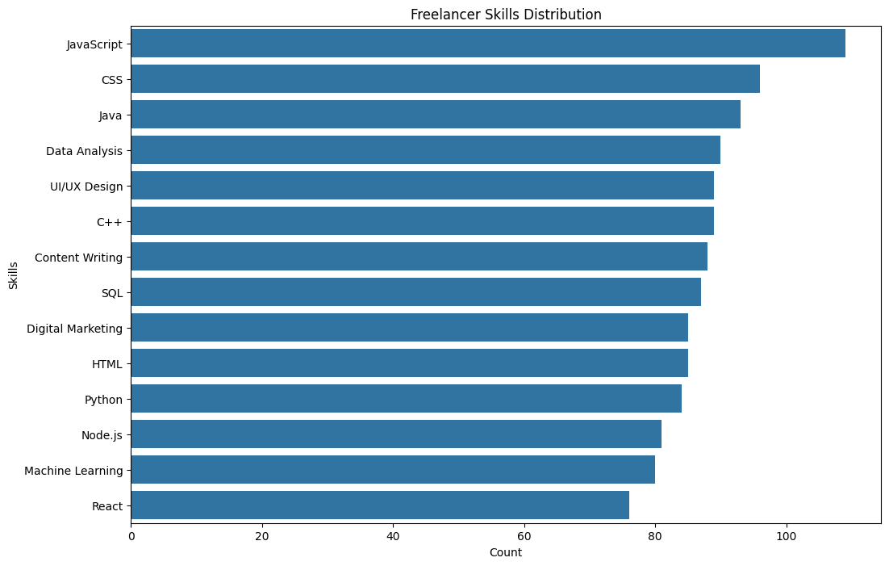
User Interface and Recommendation Generation Module Output:

Slide 35
Results and Discussions:
Results:
Collaborative Filtering Model Performance: The collaborative filtering model, based on skill overlap and user ratings, showed a Root Mean Square Error (RMSE) of around 0.9. This indicates that the system can predict ratings with a reasonably low error rate, ensuring reliable matching between freelancers and employers.
Content-Based Filtering Efficiency: The content-based filtering model, which uses TF-IDF to analyze freelancer skills, efficiently matched freelancers to employers based on skill similarity. It performed well in identifying freelancers whose skills closely matched employer needs, providing relevant recommendations.
Hybrid Model Improvement: Combining collaborative filtering with content-based filtering improved recommendation accuracy. The hybrid model balanced both approaches, providing more personalized job suggestions by weighting collaborative and content-based scores effectively.

Slide 36
Results and Discussions:
Results:
SVD Model Tuning : The SVD (Singular Value Decomposition) model tuning using grid search improved performance by identifying optimal parameters such as the number of factors and learning rate. This tuning process further reduced prediction error, enhancing overall model effectiveness.
Real-Time Performance: The system was able to handle real-time inputs from new employers and freelancers, efficiently generating recommendations with minimal delay. This feature ensures scalability and responsiveness, crucial for a dynamic freelancing platform.
Discussions:
Collaborative Filtering Limitations: Despite the effectiveness of collaborative filtering, the model struggles with new users who have little or no historical data. This "cold start" problem affects the quality of recommendations for new employers or freelancers without prior ratings or interactions.

Slide 37
Results and Discussions:
Strength of Content-Based Filtering: Content-based filtering addresses the cold start issue to an extent by focusing on user skills and preferences. This approach, however, may limit diversity in recommendations, as it only suggests freelancers with similar skills, potentially overlooking freelancers with skill sets.
Hybrid Model as a Balanced Approach:The hybrid model addresses the shortcomings of both filtering methods by combining them. This creates a more robust recommendation system that captures both user preference patterns and skill similarities, leading to more tailored and relevant job matches.
Importance of Model Tuning: Tuning the SVD model parameters was critical for improving the system’s performance. The use of GridSearchCV ensured the best configuration, which significantly improved prediction accuracy and reduced errors, making the recommendations more reliable.
Scalability and Real-World Applicability: The system demonstrated its capability to scale and provide real-time recommendations, crucial for platforms with dynamic data. The ability to handle new users and generate quick, accurate recommendations positions the system well for real-world freelancing environments.

Slide 38
Conclusion
In conclusion, the hybrid recommendation system combining collaborative filtering and content-based filtering effectively addresses the challenges of job matching in freelancing platforms. While collaborative filtering excels in leveraging historical interactions, content-based filtering compensates for the cold start problem by analyzing freelancer skills and matching them to employers' needs. The hybrid approach offers a balanced and accurate recommendation mechanism, further enhanced by SVD model tuning to minimize prediction errors and improve performance. This system, with its real-time capabilities and scalability, ensures personalized job suggestions, making it highly applicable in dynamic freelancing environments, benefiting both employers and freelancers by streamlining the job search and recruitment process.

Slide 39
References
M. Z. A. Zolfi and A. A. Puzi, "IIUM Freelance: Secure Payment Transaction by Service Progress via Mobile Application," Jan. 2024.
K. K. Beom, "Freelance Verification and Management Platform Providing System and Method," Nov. 2020.
G. B. Roth and G. D. Baer, "Cryptographic Key Escrow," Amazon.com, Mar. 14, 2016.
T. T. Ke and Y. Zhu, "Cheap Talk on Freelance Platforms," Management Science, vol. 67, no. 9, pp. 5901-5920, Jan. 2021. [The Chinese University of Hong Kong, Massachusetts Institute of Technology].
S. Krutylin, "Freelancing as a Form of Platform Employment," Economic Scope, Jan. 2024.
L. Gussek and A. Grabbe, "Challenges of IT freelancers on digital labor platforms: A topic model approach," Electronic Markets, vol. 33, no. 55, pp. 1-22, Oct. 2023, doi: 10.1007/s12525-023-00675-y.

Slide 40
Thank You

